Slide 2
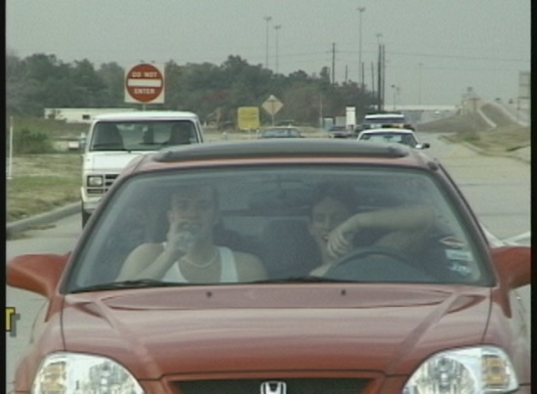
ROAD RAGE
Road Rage Causes
Youngsters learn driving behavior from their parents.
Combine youth and impatience, which equals a very aggressive group of young drivers.
Young drivers believe they can operate their cars better than professional race car drivers.
Those who pay for driving lessons soon learn that speeding, tailgating, and cutting in front of others is the usual way people drive.
When you enter your car, it is expected that there will be traffic jams, construction projects, heat, cold, and poor drivers.

Slide 3
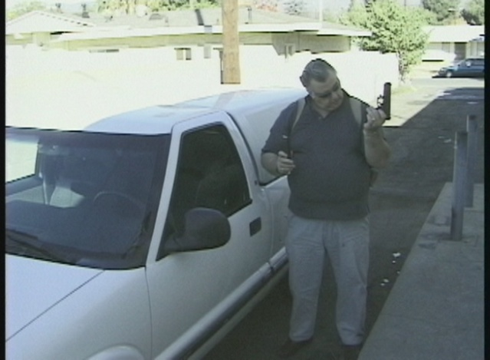
ROAD RAGE
There are the elderly, teenagers, large trucks, pedestrians that can make driving a challenge.
The highway is no place for guns or other weapons.
The next time you operate a vehicle, tell yourself that nothing will upset you.
Adjust your attitude each time you enter a vehicle.
Try not to create road rage in the other driver.
The National Highway Traffic Safety Administration found certain behaviors seem unusually likely to enrage other drivers.

Slide 4
ROAD RAGE
Prevention Techniques
Cutting Off:
make sure there is plenty of space when merging
use turn signals to show intentions before making a move
if you make a mistake, apologize with a friendly gesture
if you are cut off, slow down and give them room to merge
Drive Slow in the Left Lane:
if you are in the left lane and a driver wants to pass, move over to the right lane
use only the far left lane for passing

Slide 5
ROAD RAGE
Tailgating:
allow at least 2 to 4 second space between your car and the car ahead
large vehicles and trash trucks should use the 4 second rule
Before Cutting in Front of a Vehicle:
you should be able to see the front bumper or headlights of the car in the rear view mirror
if you are being followed too closely, signal and pull over to let the driver pass

Slide 6
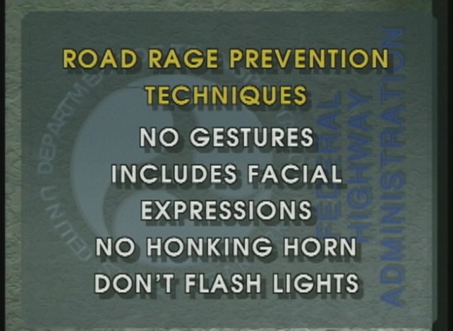
ROAD RAGE
Gestures:
avoid making any gestures that might anger another driver
never flash the lights at a driver that has made you mad
Courtesy:
signal every time you merge, change lanes, or turn.
if you and another driver approach a parking space at the same time, let the person have it
Do Not Engage:
protect yourself by not fighting with an angry driver

Slide 7
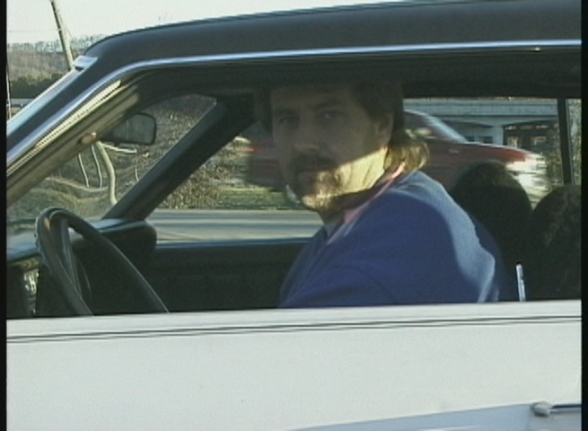
ROAD RAGE
Avoid Eye Contact:
staring at another driver can cause a fight
Get Help:
if you believe you are being followed or trying to start a fight – use your cell phone to call police, drive to a place where there is a crowd, use your horn, do not get out of the car or go to your home
Attitude Adjustment:
change your approach to driving; don’t get upset at actions of others; keep control

Slide 8
ROAD RAGE
When slowing down to turn, be aware of the driver behind you.
When turning, do it safely and quickly.
Do not run the yellow light and stop at the red light.
Check cross traffic for a vehicle that may be speeding through a caution light.
Night driving can be difficult; slow down, keep headlights on dim for approaching cars from the opposite lane.
When driving in the country at night, be cautious of deer and other animals.
With so many drivers, it is difficult to tell the good driver from the bad driver.
Avoid challenges or confrontations of an aggressive driver.

Slide 9
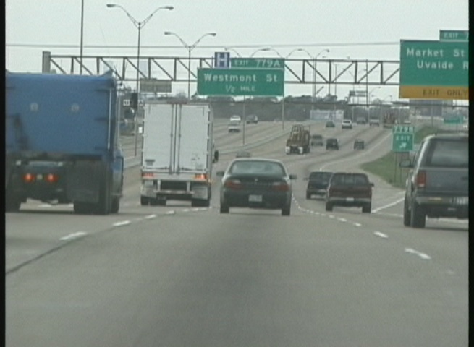
ROAD RAGE

